Slide 1
Pushdown Automata
Definition
Moves of the PDA
Languages of the PDA
Deterministic PDA’s

Slide 2
Pushdown Automata
The PDA is an automaton equivalent to the CFG in language-defining power.
Only the nondeterministic PDA defines all the CFL’s.
But the deterministic version models parsers.
  Most programming languages have deterministic PDA’s.

Slide 3
Deterministic PDA’s
To be deterministic, there must be at most one choice of move for any state q, input symbol a, and stack symbol X.
In addition, there must not be a choice between using input ε or real input.
Formally, δ(q, a, X) and δ(q, ε, X) cannot both be nonempty.

Slide 4
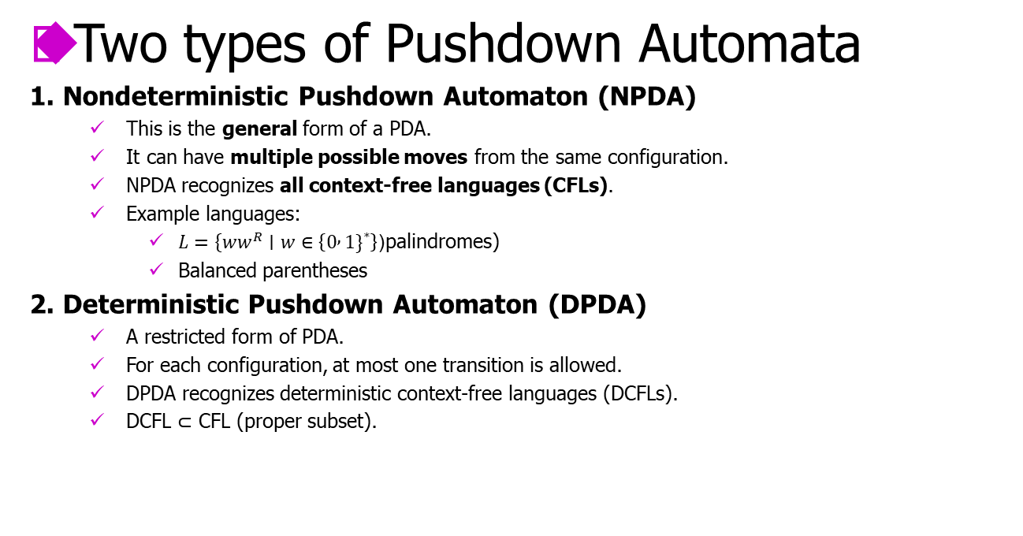
Deterministic PDA’s

Slide 5
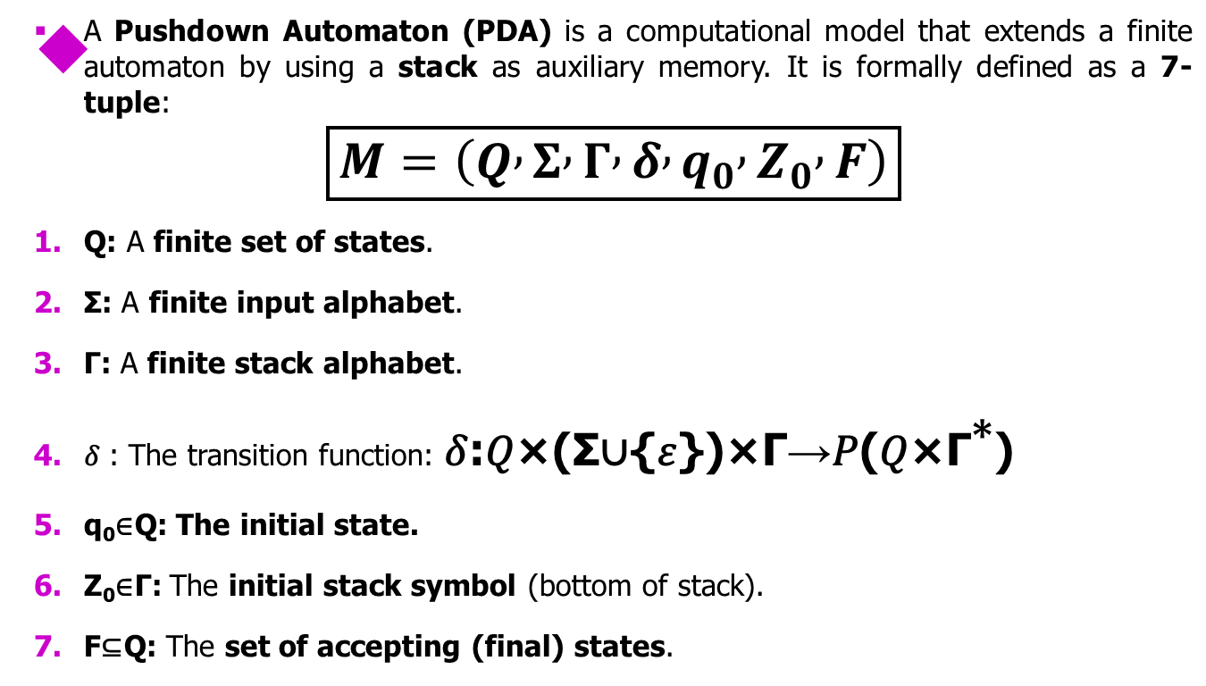
Formal Definition of a Pushdown Automaton (PDA)

Slide 6
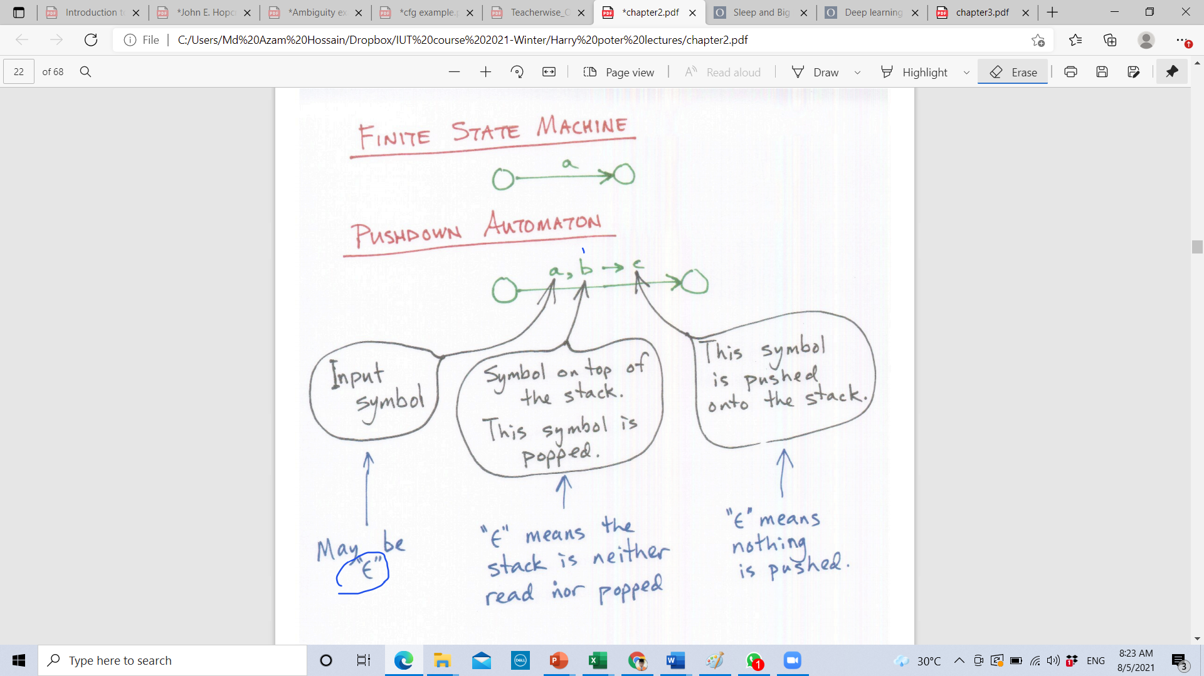
FSM vs PDA

Slide 7
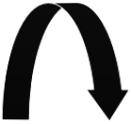
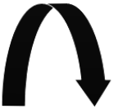
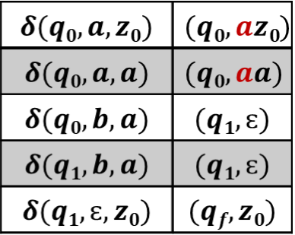
Example of PDA
L = {a^{n}b^{n} | n>=1}
  Number a’s followed by equal number of b’s
  Push a’s after that once b’s encounter move to next state and pop the a’s until stack become empty.
a, a→ a
b, a→ ɛ
a, z₀→ a
q₀
q₁
ɛ, z₀→ z₀
q_{f}
Transition Function
b, a→ ɛ
z₀
a
a
a | a | a | b | b | b
a

Slide 8


Example of PDA
L = {w | n_{a}(w) = n_{a}(w)}
  Number a’s equal to number of b’s
  Order does not matter
b, z₀→ b
a, z₀→a z₀
q₀
ɛ, z₀→ z₀
q_{f}
z₀
a, a→ a
b, b→ b
b
a, b→ ɛ
b, a→ ɛ
a
a | b | a | b | b | a
Next input is empty and top of the stack is z₀ so we can move to final state

Slide 9


Example of PDA
L = {a^{n}b^{n}c| n>=1}
  Number a’s followed by equal number of b’s and string end with c’s.
  Push a’s after that once b’s encounter move to next state and pop the a’s until stack become empty.
  Get c’s and top of stack is z₀, go to final state.
a, a→ a
b, a→ ɛ
a, z₀→ a
q₀
q₁
c, z₀→ z₀
q₂
ɛ, z₀→ z₀
q_{f}
b, a→ ɛ

Slide 10
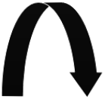
Example of PDA
L = {a^{n}b^{n}c^{m}| n,m>=1}
  Number a’s followed by equal number of b’s and string end with c’s.
  Push a’s after that once b’s encounter move to next state and pop the a’s until stack become empty.
  Get 1/m number of c’s and top of stack is z₀, go to final state.
a, a→ a
c, z₀→ z₀
b, a→ ɛ
a, z₀→ a
q₀
q₁
c, z₀→ z₀
q₂
ɛ, z₀→ z₀
q_{f}
b, a→ ɛ

Slide 11
Example of PDA
L = {a^{n}b^{m}c^{n}| n,m>=1}
  Number a’s followed by equal number of b’s and string end with c’s.
  Push a’s after that once b’s encounter move to next state and pop the a’s until stack become empty.
  Get 1/m number of c’s and top of stack is z₀, go to final state.
a, a→ a
c, a→ ɛ
b, a→ a
a, z₀→ a
q₀
q₁
c, a→ ɛ
q₂
ɛ, z₀→ z₀
q_{f}
b, a→ a

Slide 12


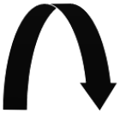

Example of PDA
L = {a^{n}b^{m+n}c^{m}| n,m>=1}
Rewrite: a^{n}b^{n}b^{m}c^{m}
a, a→ a
b, a→ ɛ
c, b→ ɛ
a, z₀→ a
q₀
q₁
c, b→ ɛ
q₂
ɛ, z₀→ z₀
q_{f}
b, a→ ɛ
b, z₀→ b
b, b→ b

Slide 13


Example of PDA
L = {a^{n+m}b^{m}c^{n}| n,m>=1}
a, a→ a
b, a→ ɛ
c, a→ ɛ
a, z₀→ a
q₀
q₁
c, a→ ɛ
q₂
ɛ, z₀→ z₀
q_{f}
b, a→ ɛ

Slide 14
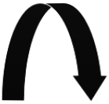

Example of PDA
L = {a^{n}b^{2n}| n>=1}
Push to 2 a’s –pop 1 b’s
a, a→ aa
b, a→ ɛ
a, z₀→ aa
q₀
b, a→ ɛ
q₁
ɛ, z₀→ z₀
q_{f}

Slide 15
Example of PDA
L = {a^{n}b^{2n+1}| n>=1}
Push to 2 a’s –pop 1 b’s
Take 1 more b’s and then go to final state
a, a→ aa
b, a→ ɛ
a, z₀→ aa
q₀
q₁
b, z₀→ z₀
q₂
ɛ, z₀→ z₀
q_{f}
b, a→ ɛ

Slide 16
Example of PDA
L = {a^{n+m}b^{m}c^{n}| n,m>=1}
a, a→ a
b, a→ ɛ
c, a→ ɛ
a, z₀→ a
q₀
q₁
c, a→ ɛ
q₂
ɛ, z₀→ z₀
q_{f}
b, a→ ɛ

Slide 17
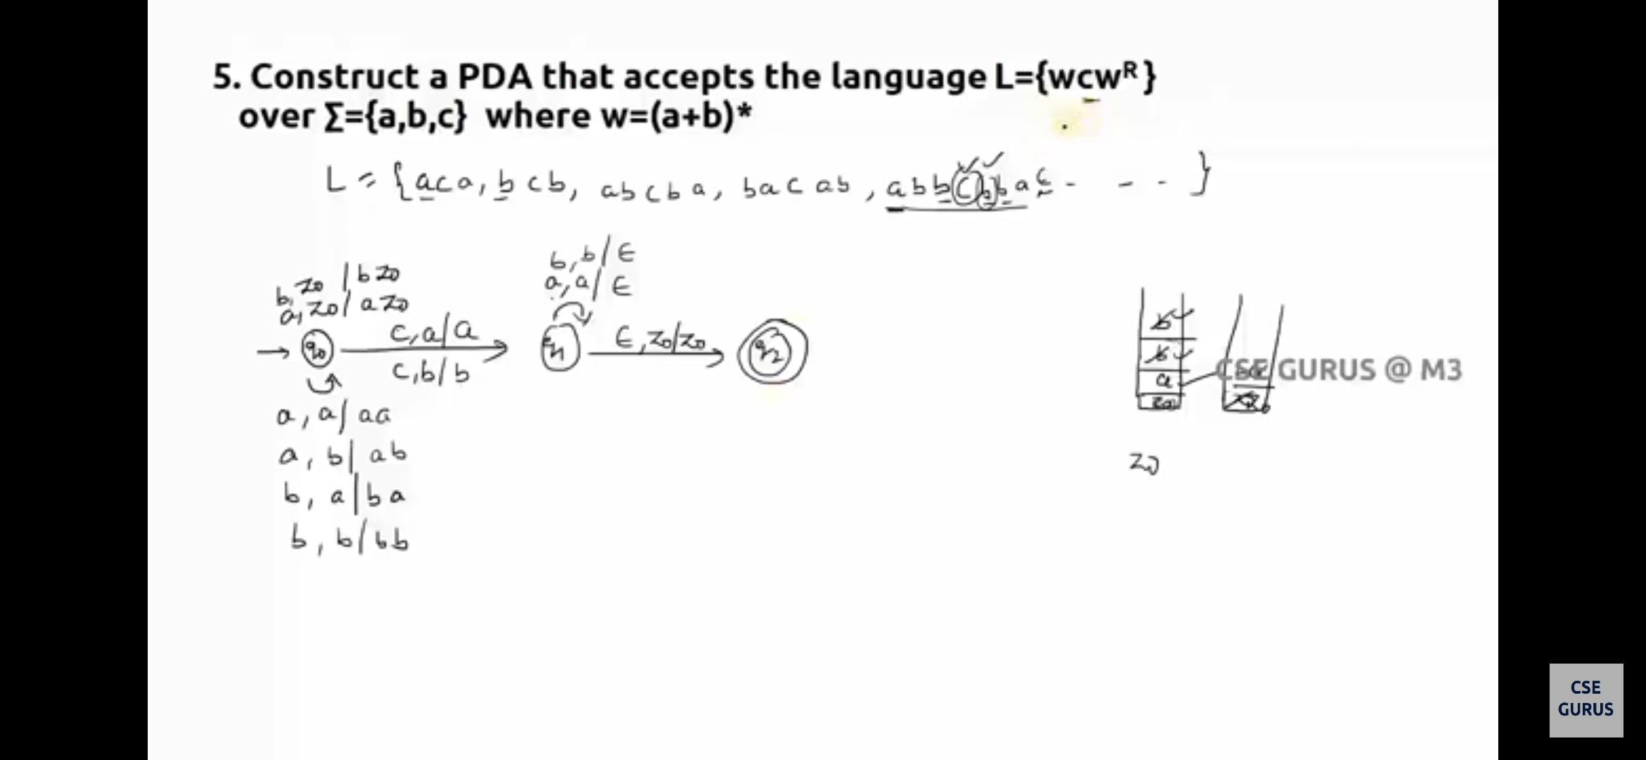
Example of PDA

Slide 18
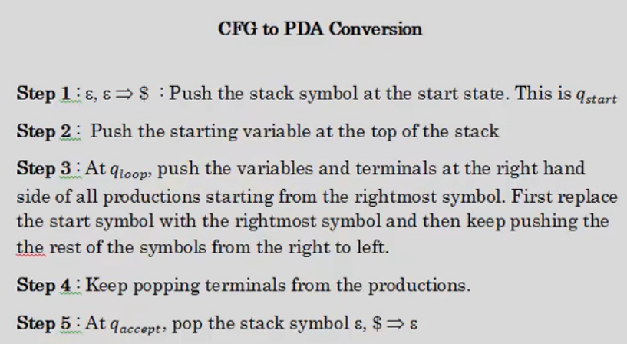
CFG to PDA Conversion Steps
ɛ, ɛ → z₀
ɛ, ɛ → z₀
ɛ, z₀ → ɛ
ɛ, z₀ → ɛ

Slide 19
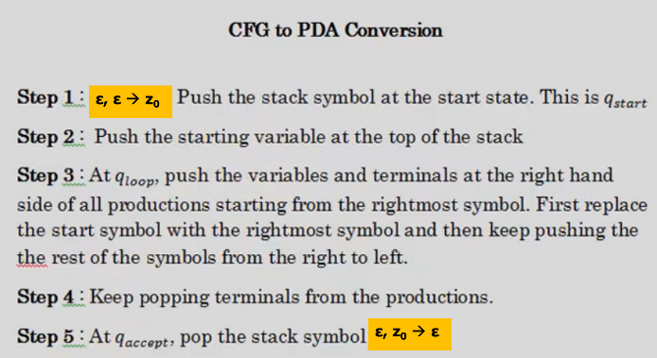
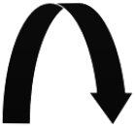
CFG to PDA Conversion
Convert this CFG into a PDA
  S → aBc | ab
  B → SB | ɛ
a, a→ ɛ
b, b→ ɛ
b, b→ ɛ
q₀
ɛ, ɛ → z₀
q₁
ɛ, ɛ → S
q_{loop}
ɛ, z₀→ ɛ
q_{f}
ɛ, S → c
ɛ, B → ɛ
ɛ, ɛ → S
ɛ, ɛ → B
ɛ, S → b
ɛ, ɛ → a
ɛ, B → B
ɛ, ɛ → a

Slide 20
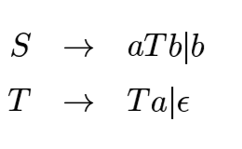
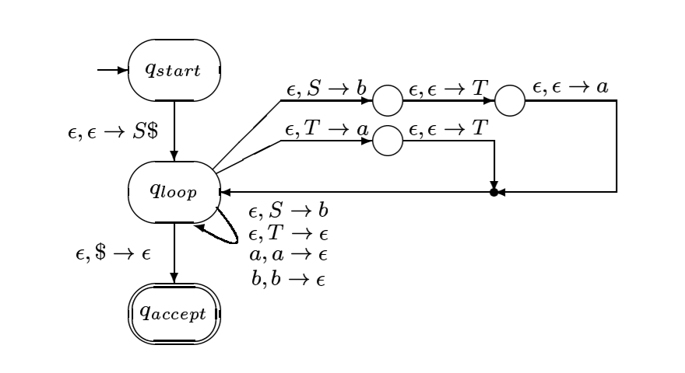
CFG to PDA Conversion

Slide 21
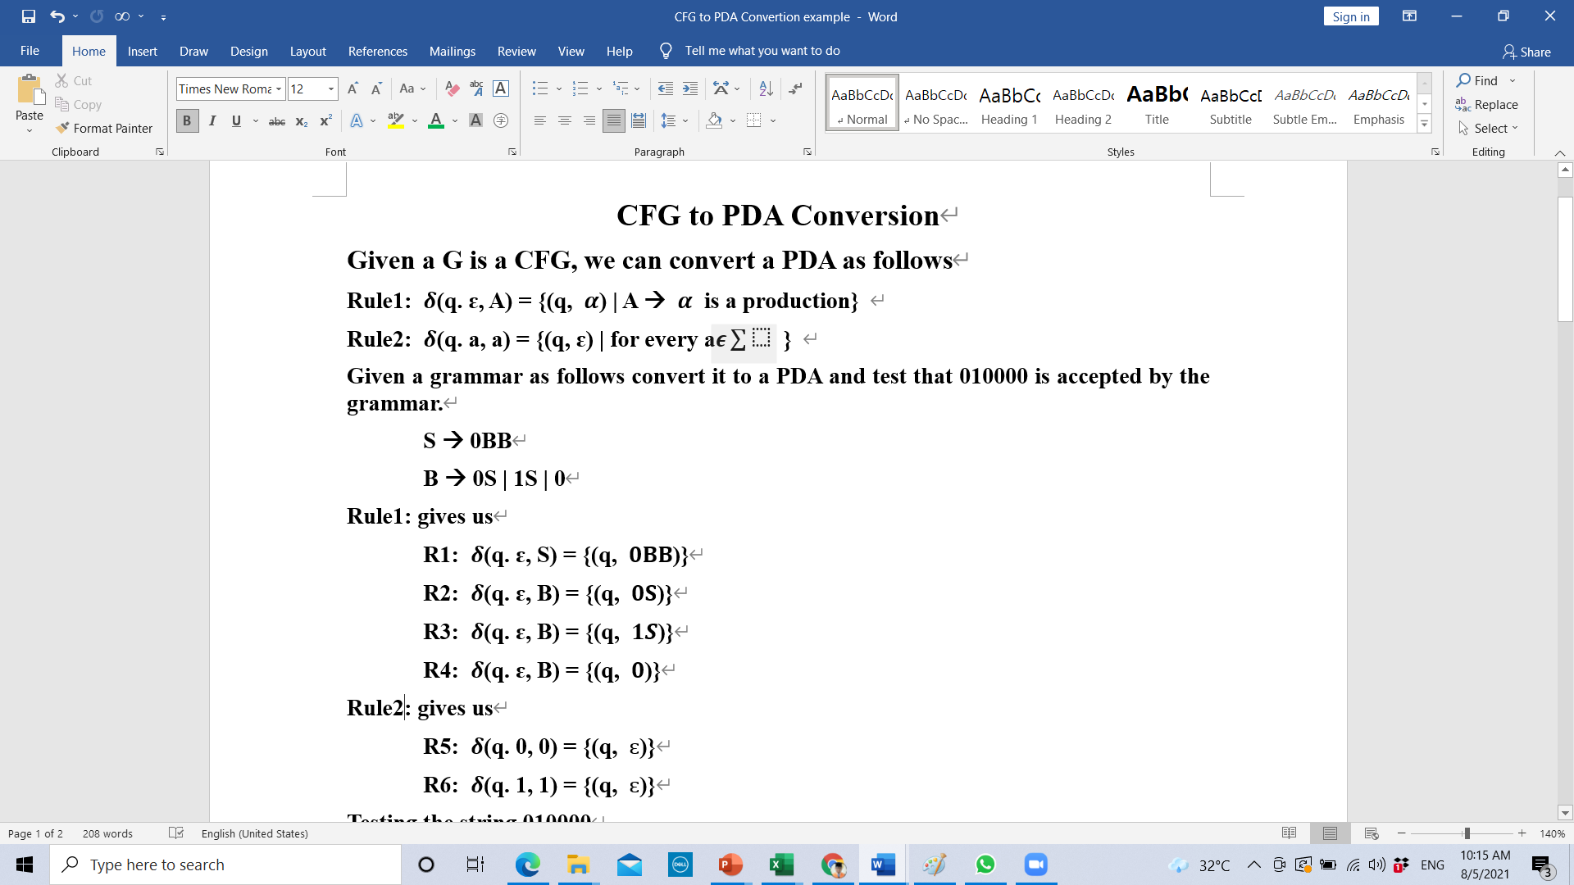
CFG to PDA Conversion-2

Slide 22
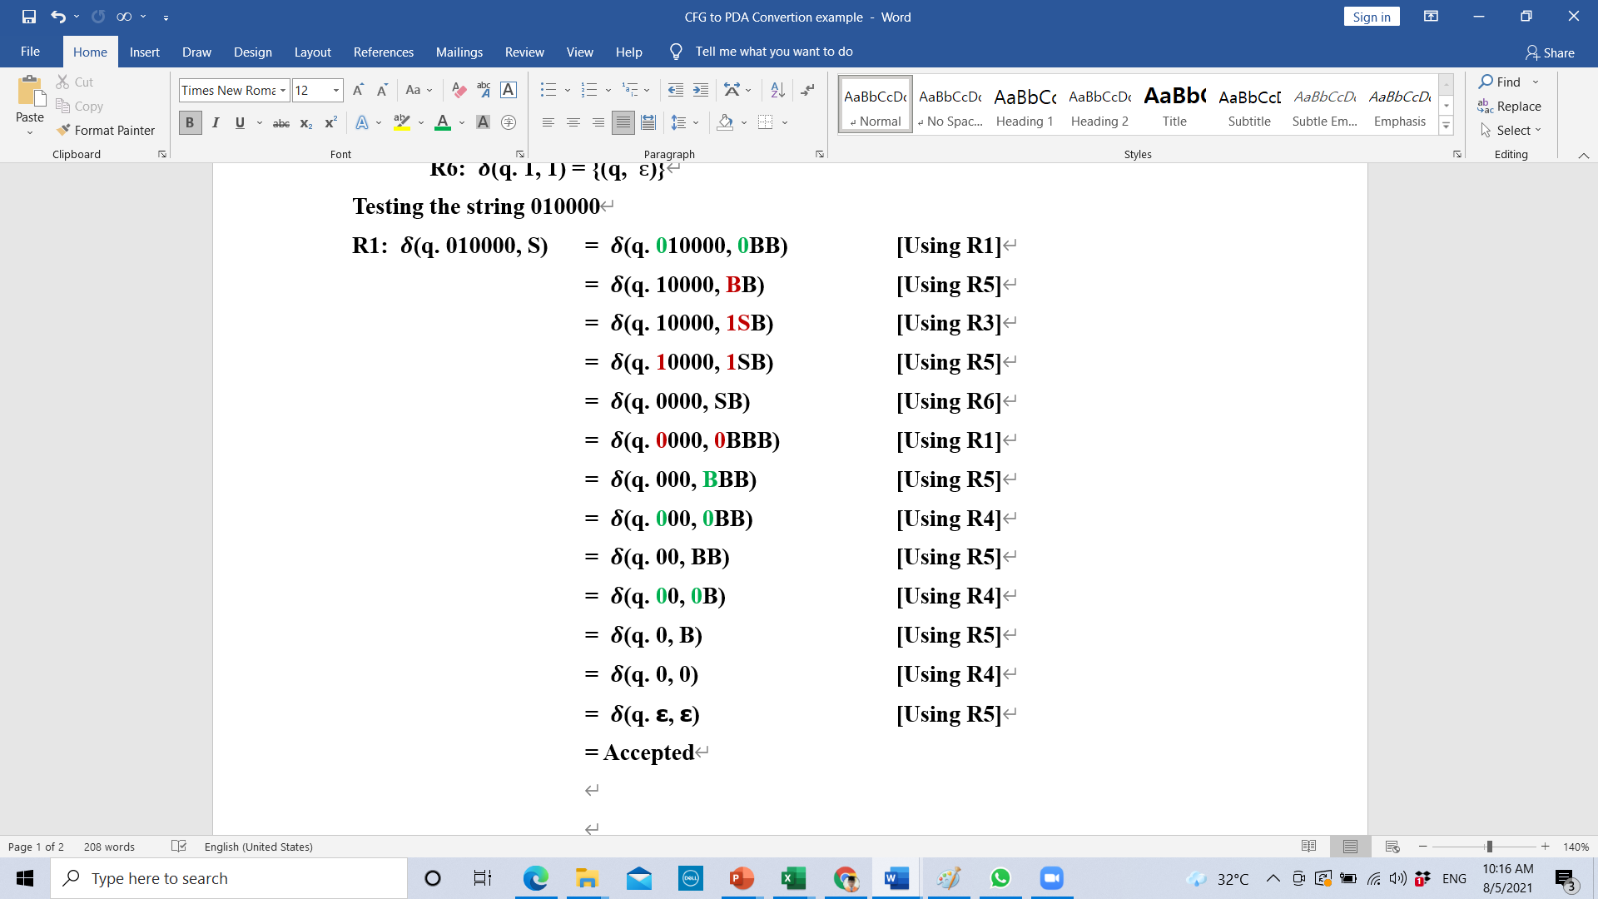
CFG to PDA Conversion-2 Cont..

